Slide 1

JavaScript
Day 23

Slide 2
1
Introduction to the use of javascript in web dev
2
How to write javascript
3
DOM Manipulation
Outline Class
4
Variable
5

Slide 3
Introduction to the use of javascript in web dev
JavaScript is a popular programming language used to create websites with dynamic website content.
Dynamic content means content can move or change in front of the screen without needing to reload the page. For example, photo slideshow features, animated images, poll filling, and others.
JavaScript Dynamic Website
JavaScript itself is actually usually collaborated with HTML and CSS. Where HTML is used to create website structures and CSS to design website page styles. Then, JavaScript plays the role of adding interactive elements to increase user engagement.

Slide 4
How To Write JavaScript
Types of Javascript
We can write the javascript code in three various ways, they are :
Inline javascript
Internal Javascript
External Javascript

Slide 5

Inline javascript
Inline javascript is written within the html tags

Slide 6
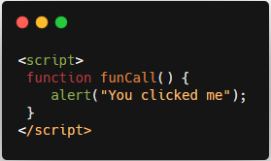
Internal/ embeded Javascript
Internal javascript is written inside the <script> and </script> tags.

Slide 7

External Javascript
External javascript is written in a separate file and saved with .js extension.
External javascript file can be imported inside the html file using src attribute in <script> tag.

Slide 8
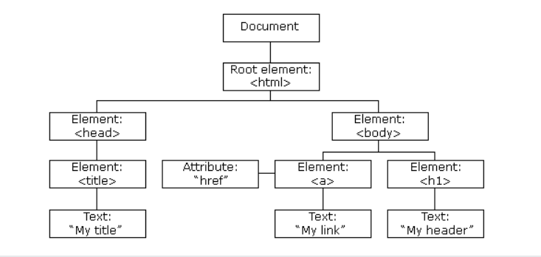
JavaScript HTML DOM
The HTML DOM (Document Object Model)
When a web page is loaded, the browser creates a Document Object Model of the page.
The HTML DOM model is constructed as a tree of Objects:

Slide 9
What is the HTML DOM ?
The HTML DOM is a standard object model and programming interface for HTML. It defines:
The HTML elements as objects
The properties of all HTML elements
The methods to access all HTML elements
The events for all HTML elements
In other words: The HTML DOM is a standard for how to get, change, add, or delete HTML elements.

Slide 10
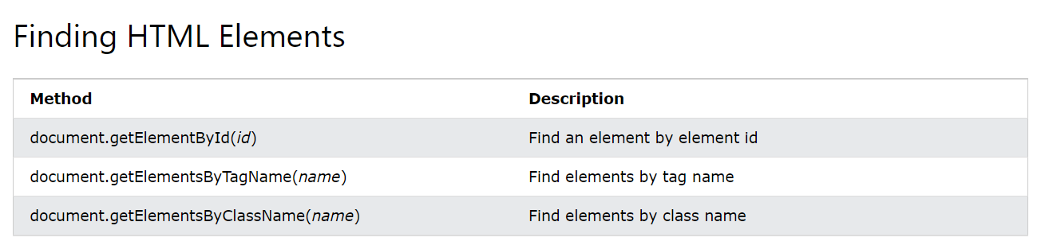
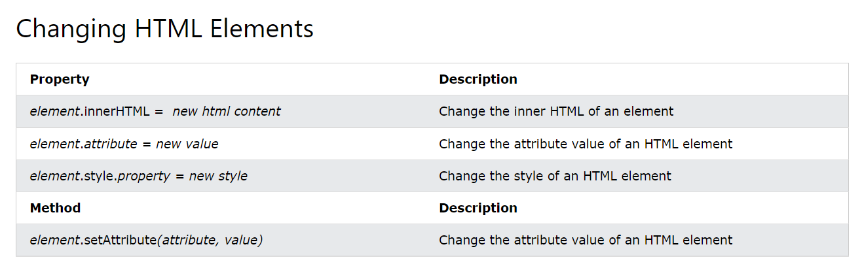
DOM Document Object

Slide 11
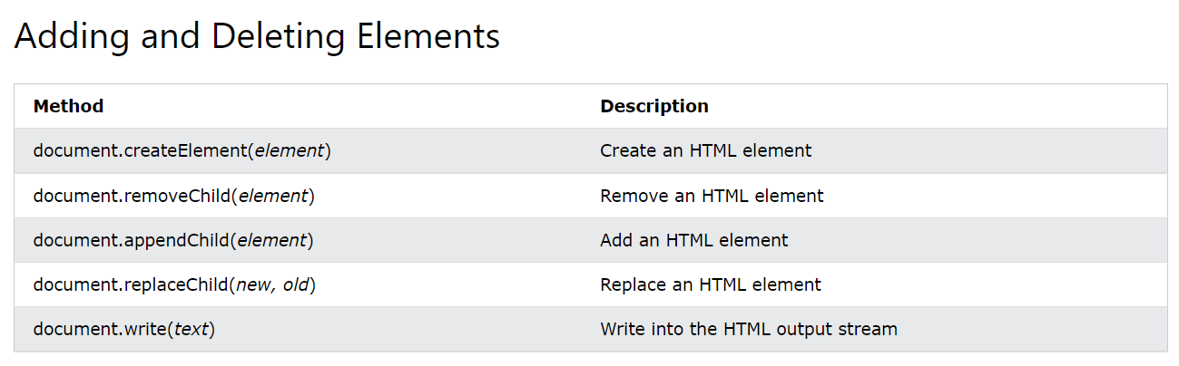

Slide 12
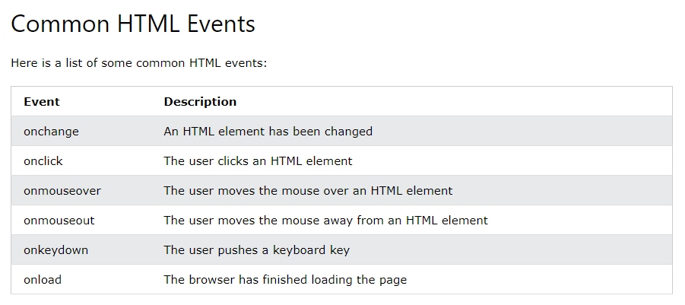
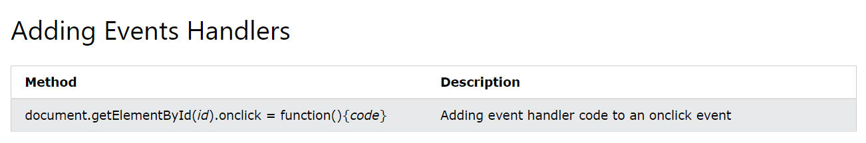

Slide 13
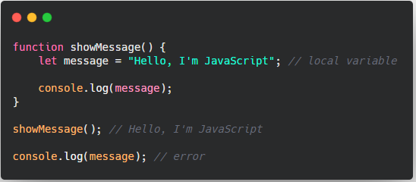
Local Variable
Variable
A variable declared inside a function is only visible inside that function.

Slide 14
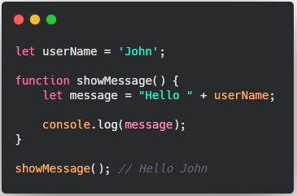
Outer Variable
Variables declared outside of any function, such as the outer userName in the code above, are called global.

Slide 15
Thank you

